Slide 1
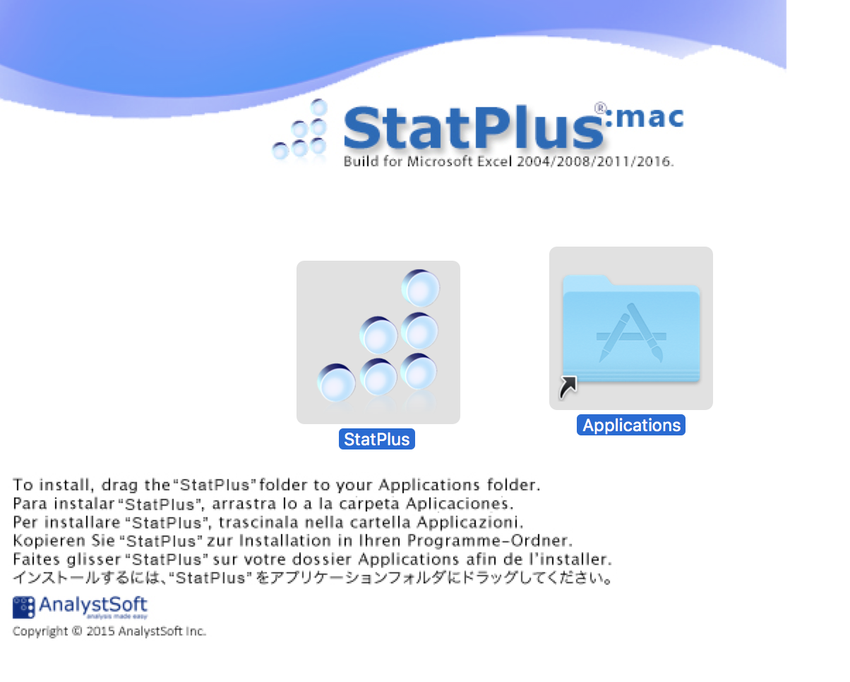
StatPlus:mac requires Mac OS 10.7 or newer, builds for Mac OS 10.4-10.6 and PowerPC are available on request.
Please contact us at http://support.analystsoft.com if you have any questions or issues.

Slide 2
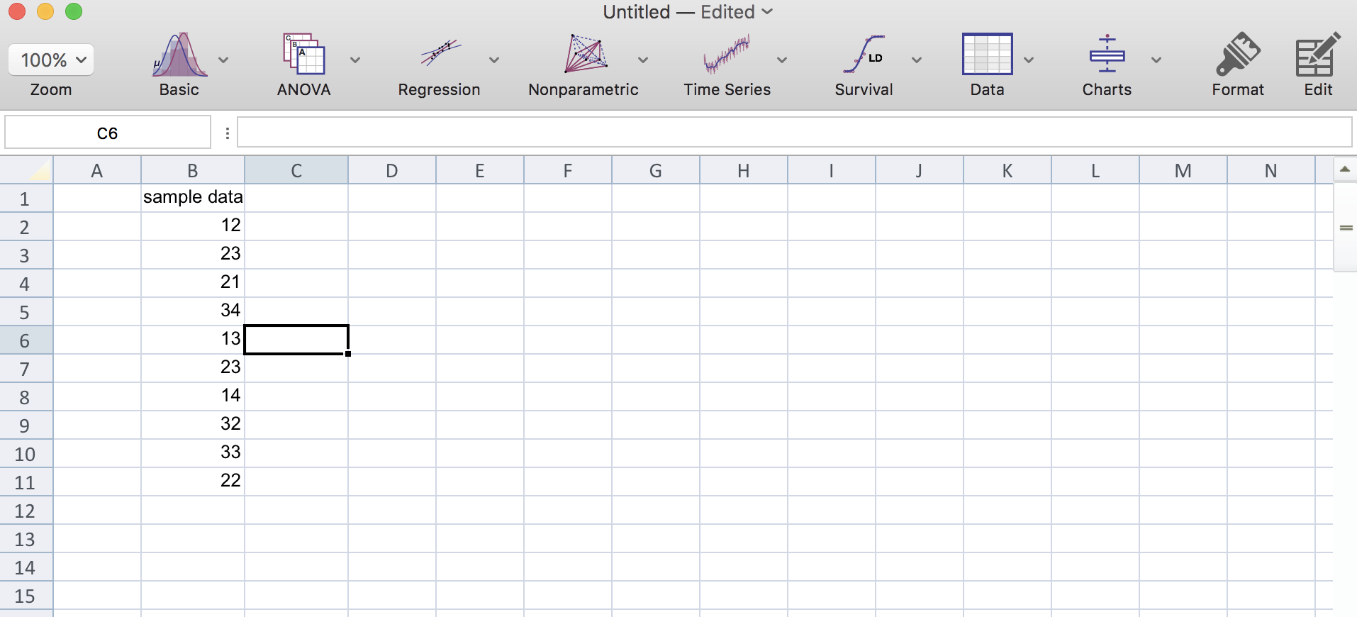
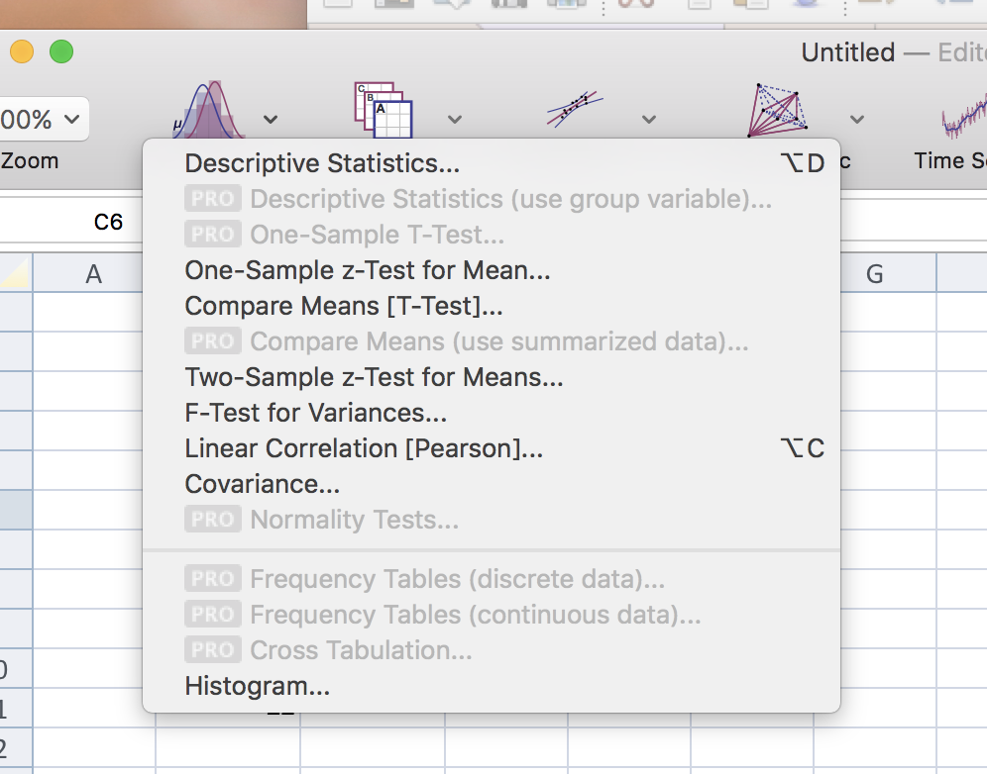
“Descriptive statistics” function can be found here

Slide 3
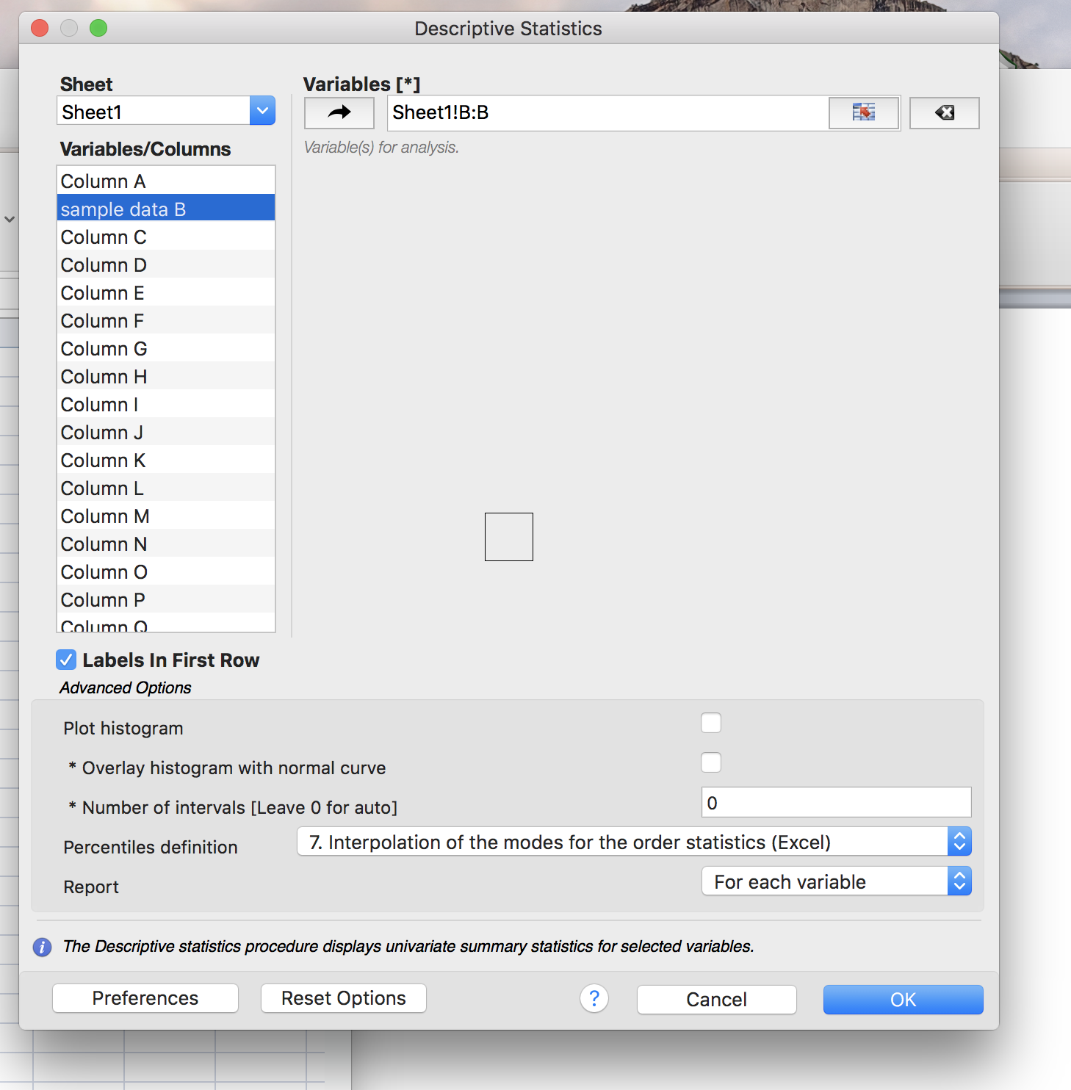
1) Select/click on the data you want to manipulate
2) Then click here so that the location of that data shows in this box

Slide 4
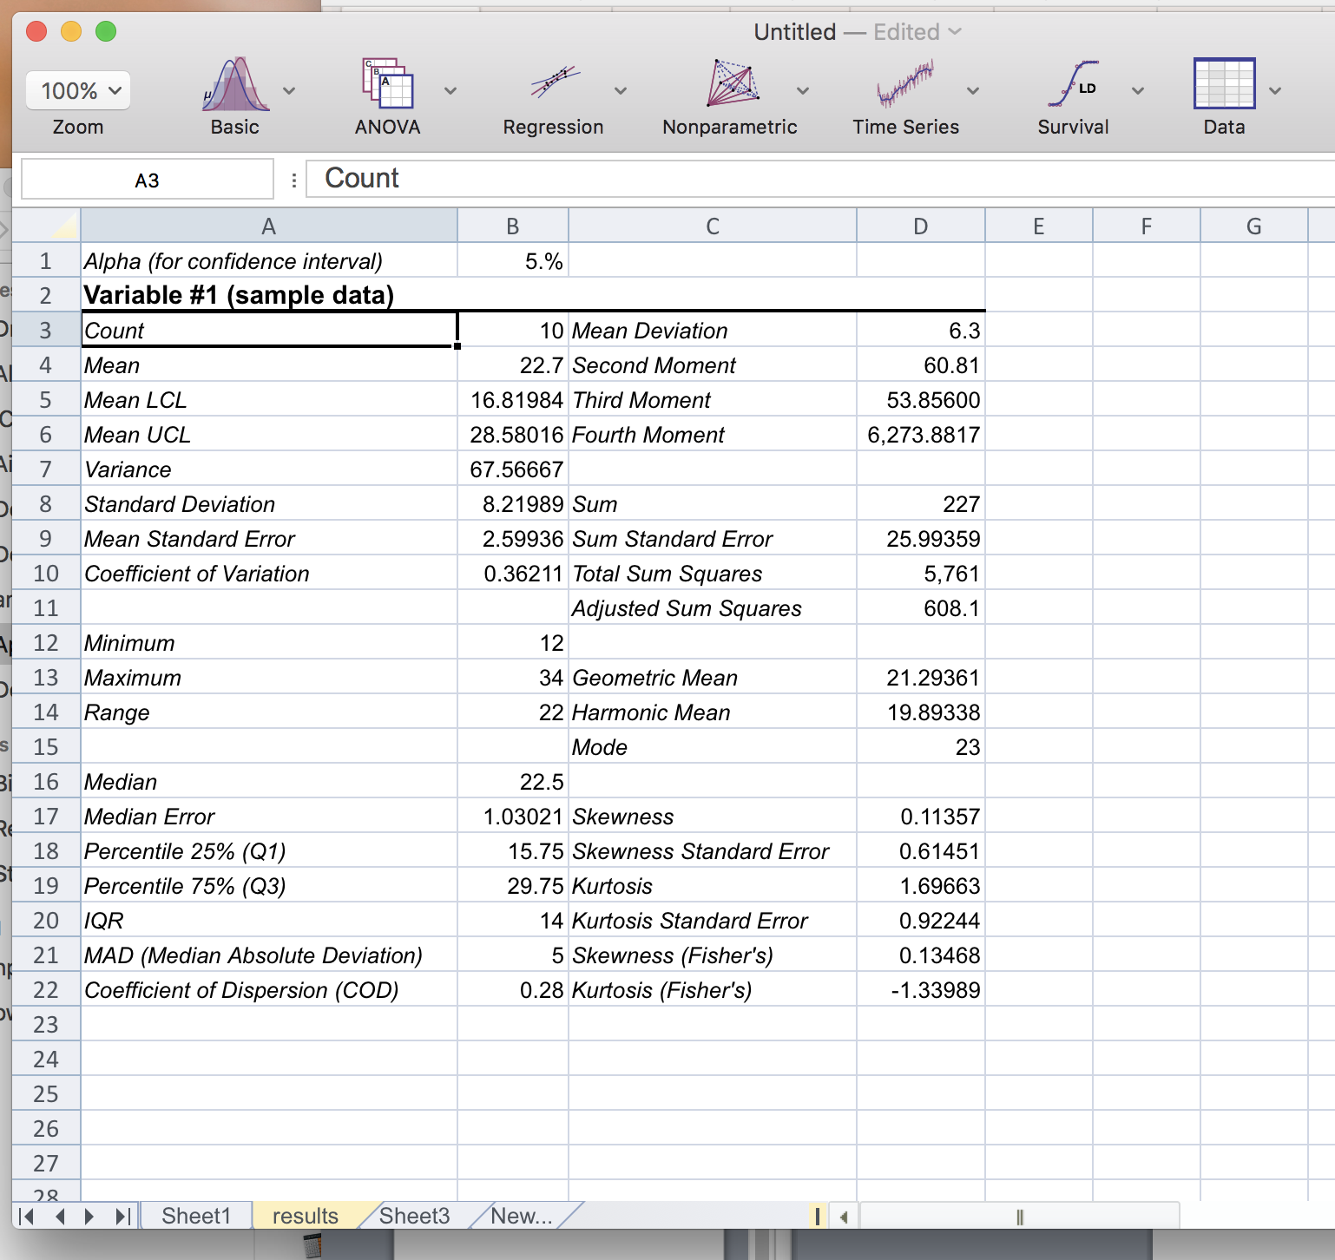
Once you select <OK> then the results will show up on a new worksheet

Slide 5
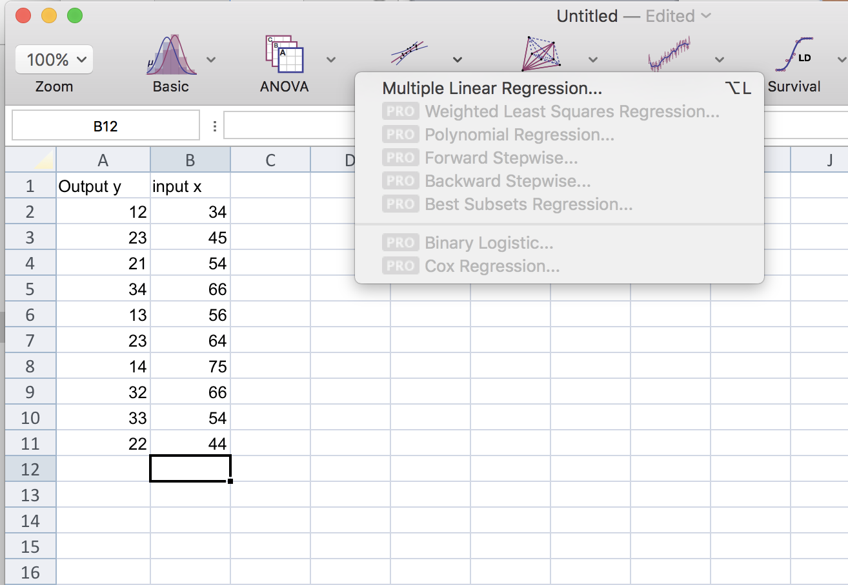
Select this if you want to run a regression
The other options listed are only available if you purchase the “Pro” version of this software

Slide 6
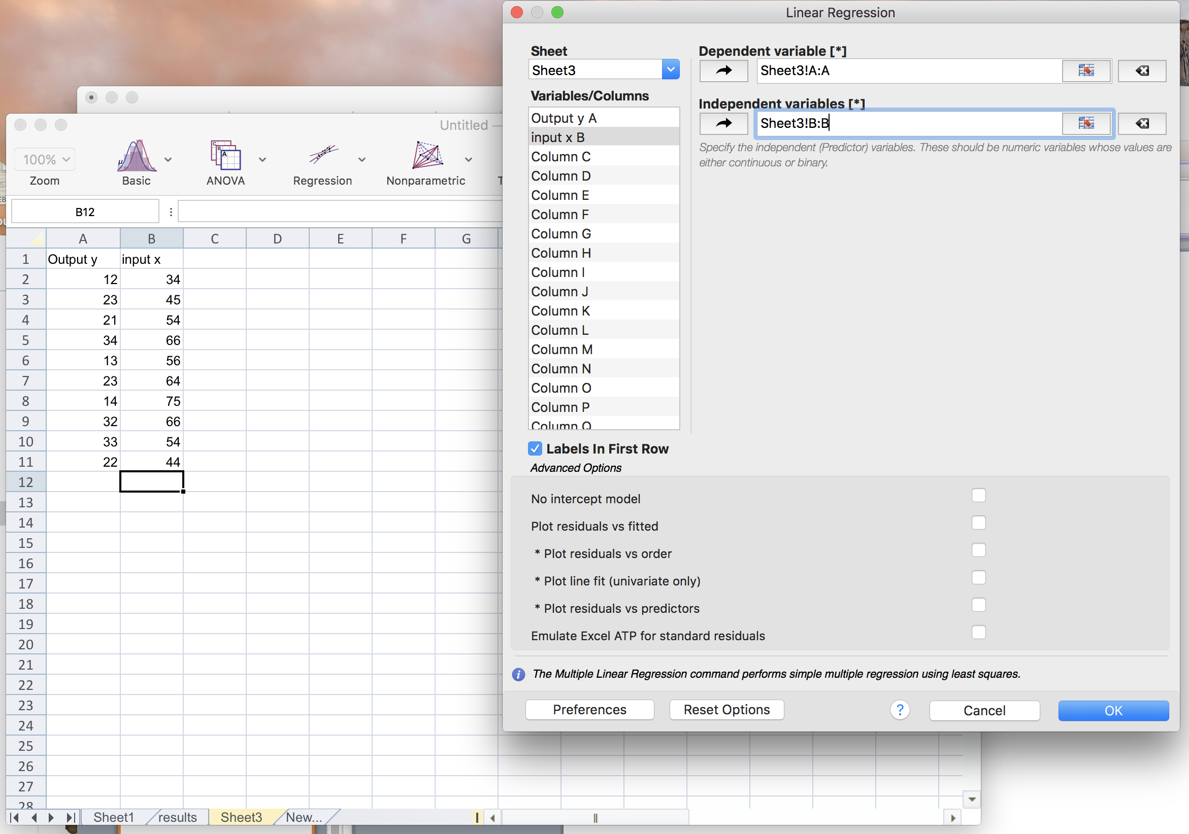
Click on this arrow to get the data range to show up in this white box …Dependent variable = Output (y)
Select the data you want to analyze from this list (notice this particular data is on “Sheet3”)
Click on the arrow to get the data range to show up in this white box …Independent variable = Input (x)

Slide 7
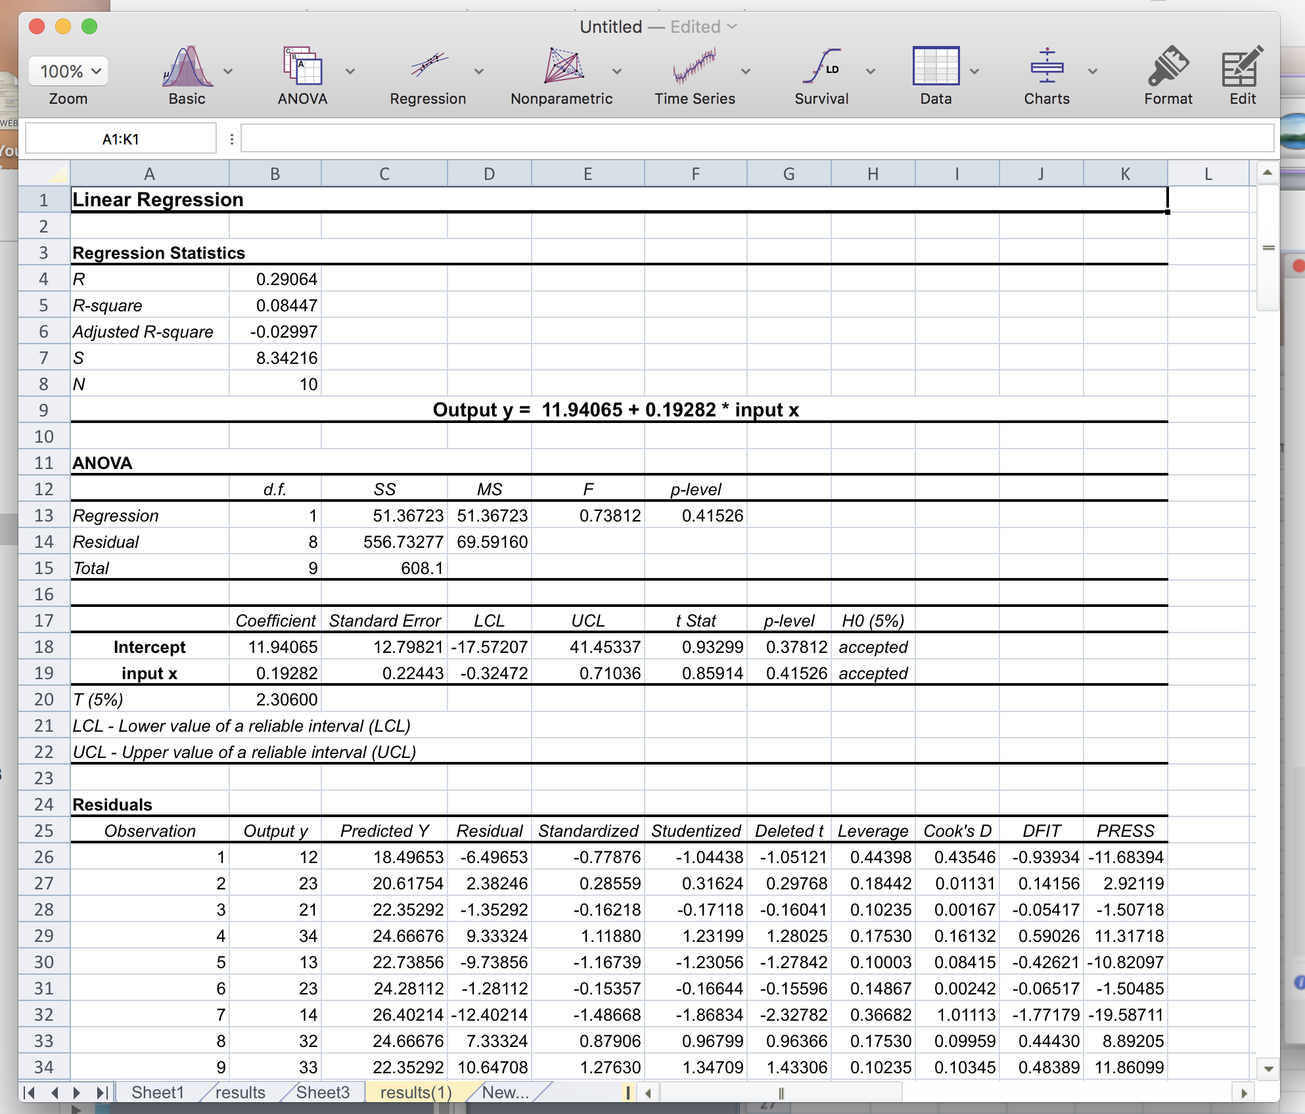
Once you click on <OK> then the results will show up on a new worksheet
Regression equation coefficients are here

Slide 8
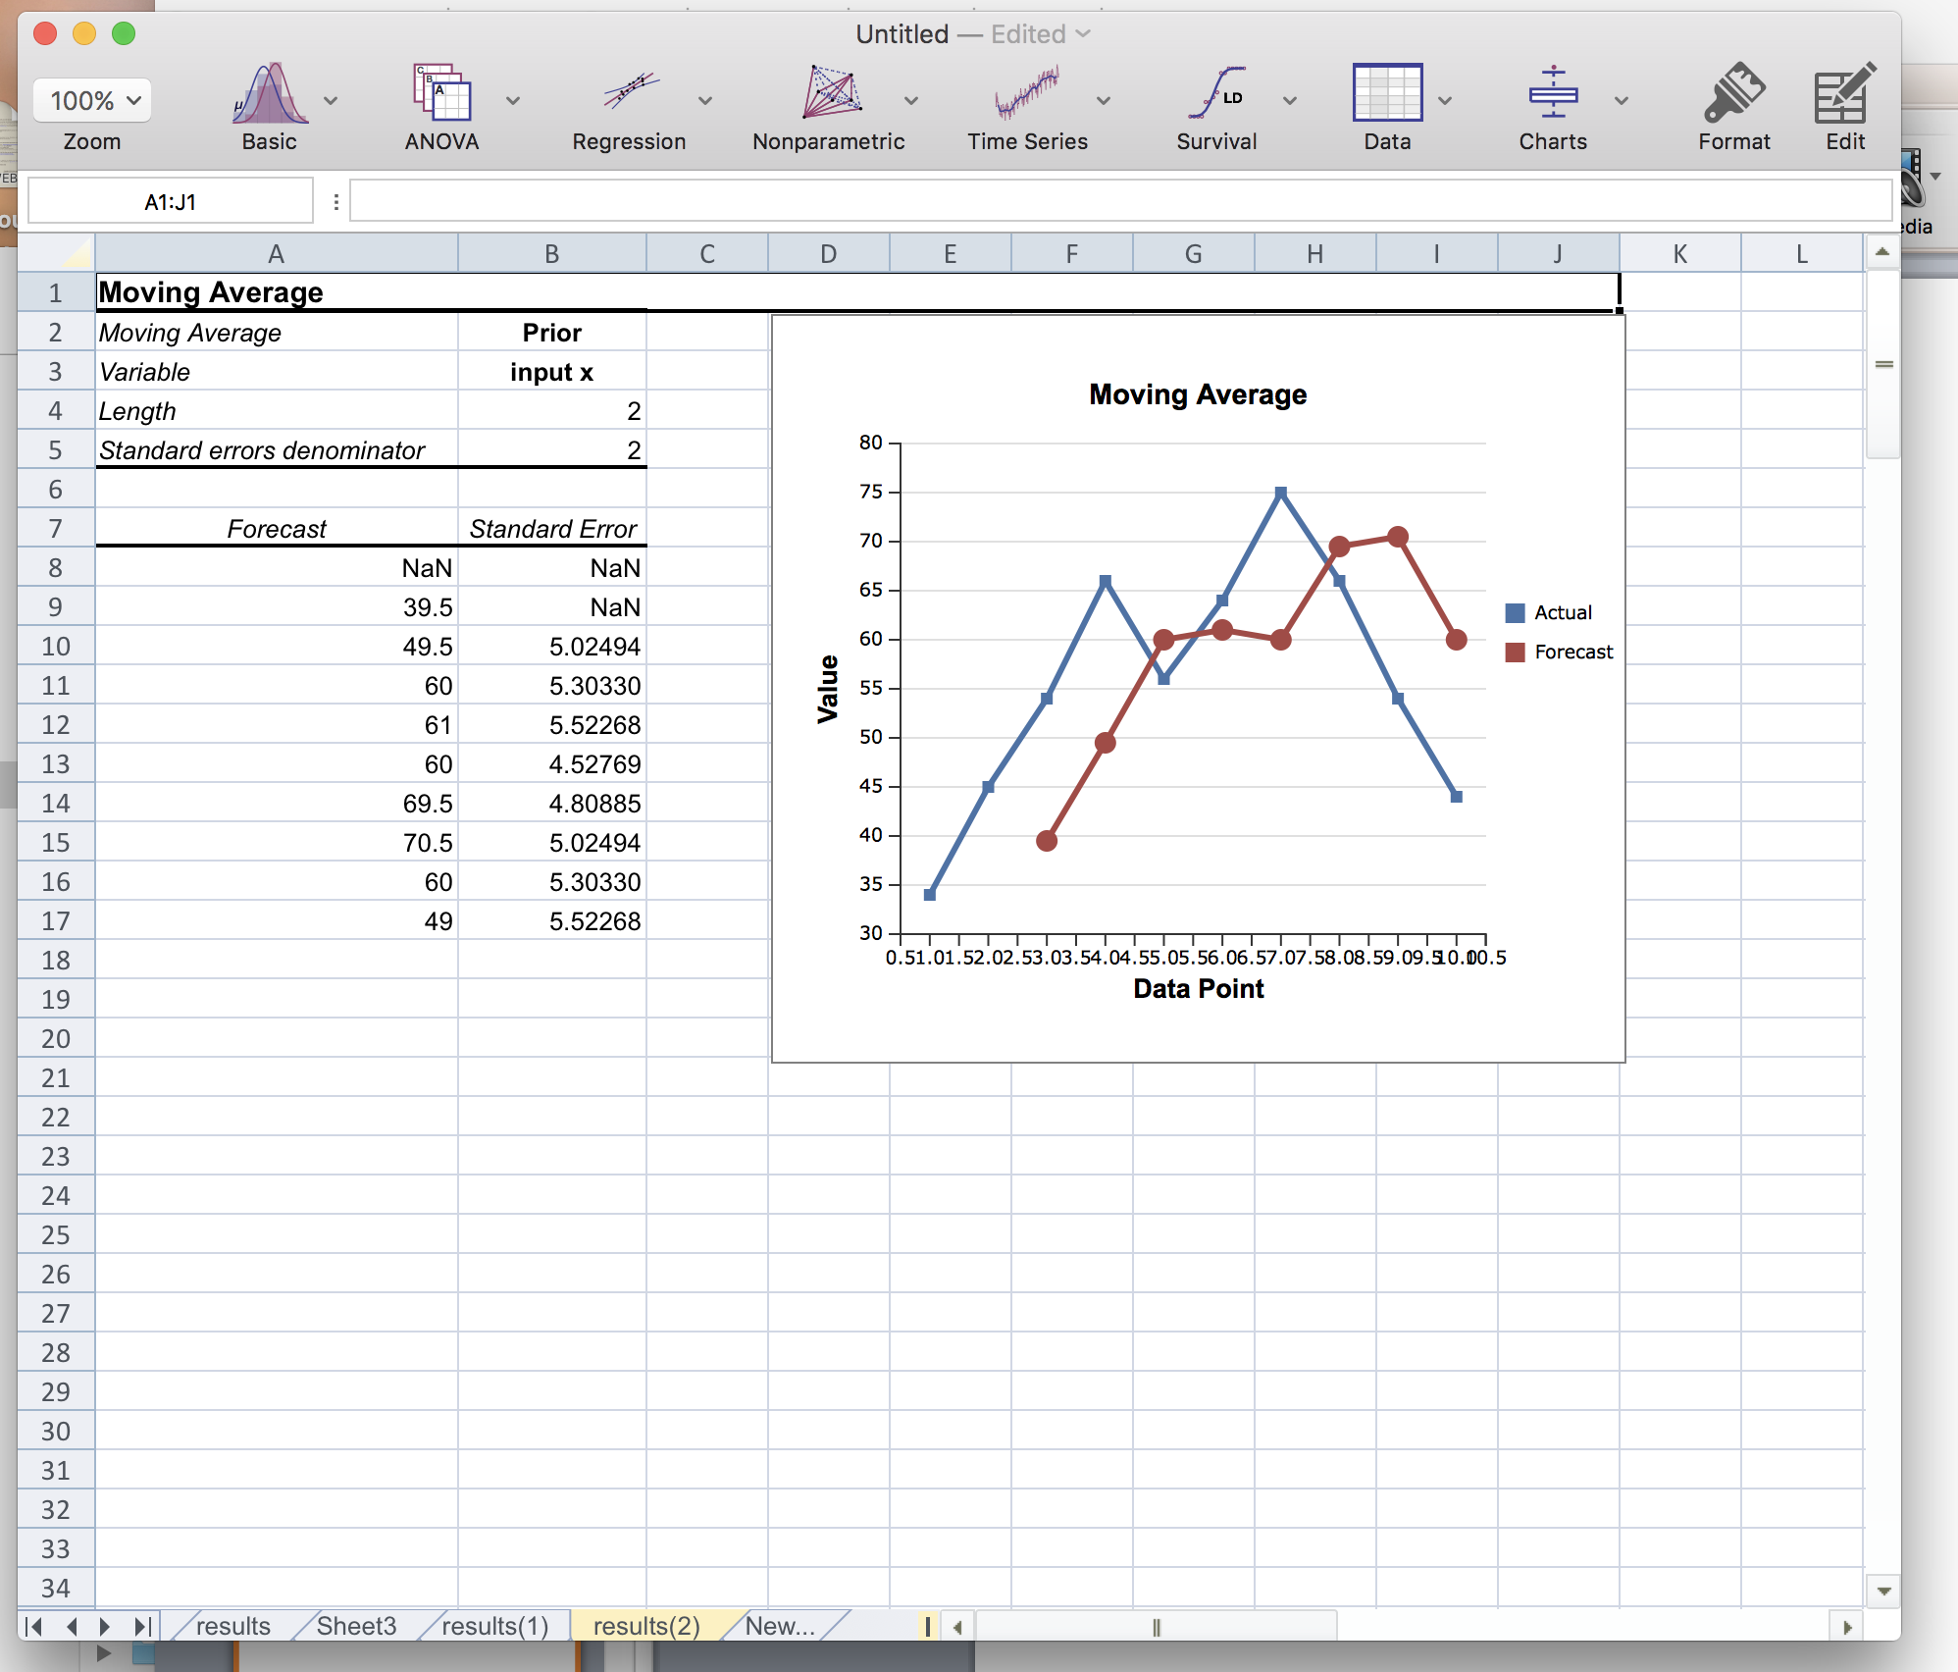
To perform Time Series analysis click here

Slide 9
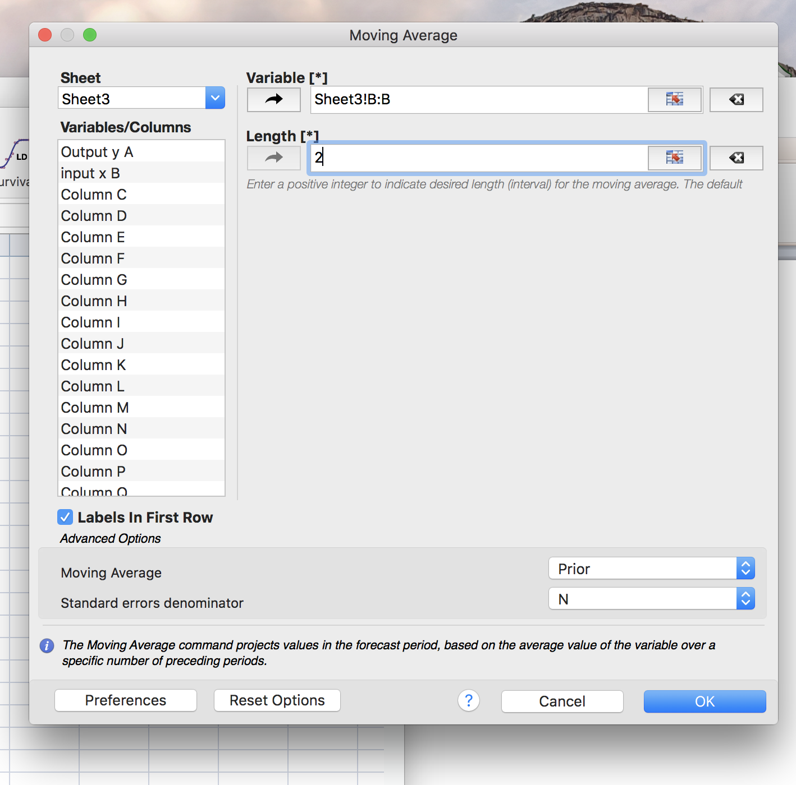
This dialog box will pop up when choosing the Moving Average time series forecasting technique from the “Time Series” menu item
Select the column of data you want to manipulate (data you are using to create the forecast )
Length = interval (k) the number of prior periods to include in the moving average

Slide 10
Click on <OK> …generates the forecasting results…and they appear on a new worksheet.

Slide 11
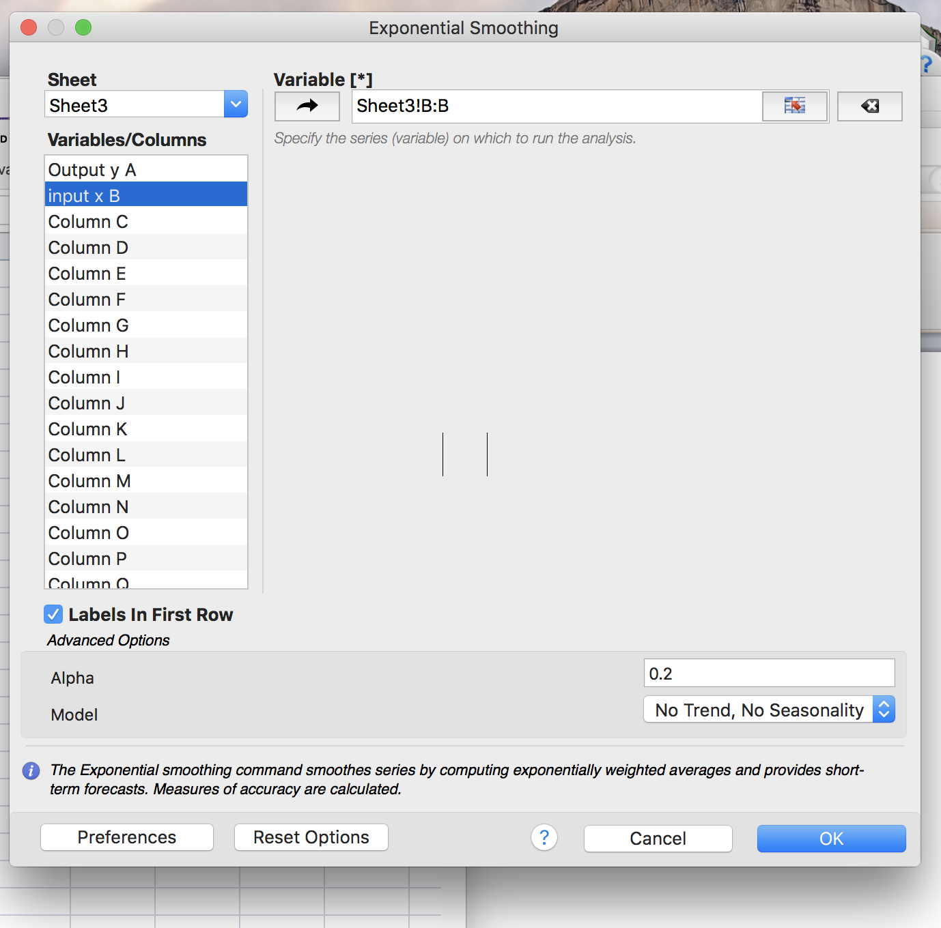
Choose Time Series; then Exponential Smoothing
Select the column of data you want to manipulate (data you are using to create the forecast )
Choose a number from 0 – 1 to enter here. This is the smoothing constant. A higher smoothing constant puts more weight on the most recent forecasted values.

Slide 12
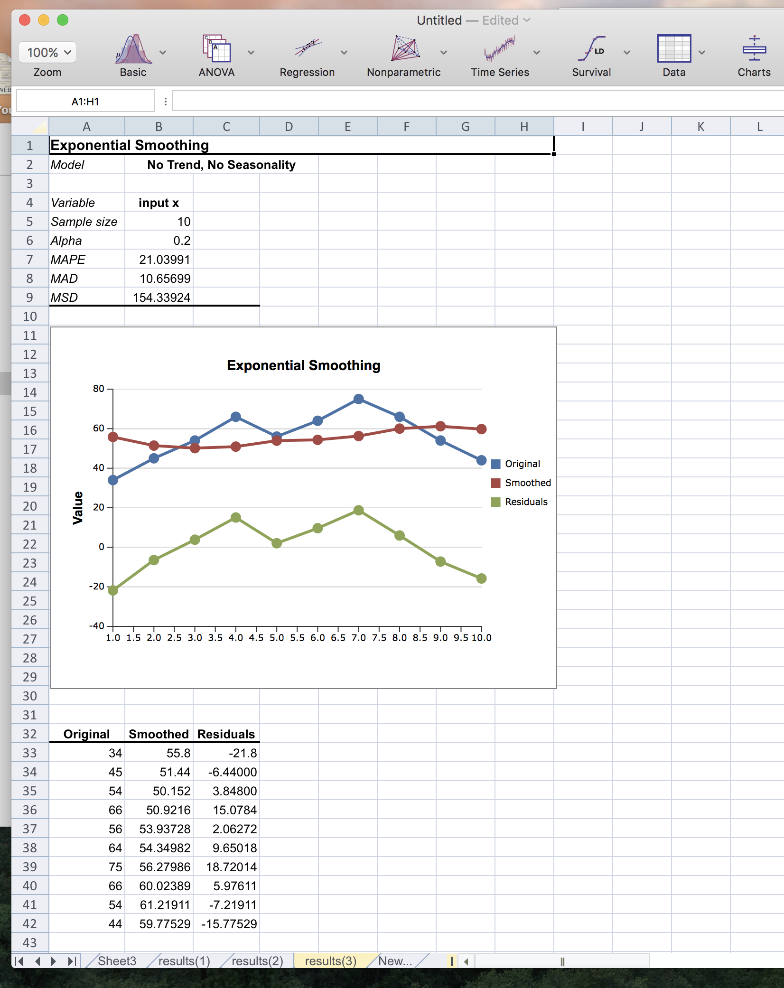
Similar to the other functions…
Click <OK> which generates the forecasted results on a new worksheet.
StatsPlus differs from the Excel ToolPak by calculating the first value in the time series differently, hence all of the subsequent values will vary.
StatsPlus calculates the average of all the data points in the column and calls that (55.8) the first “smoothed” value. The Excel ToolPak considers the original value (34) as the first value in the “smoothed” forecast.

